Slide 1
Basic Elements of LLM

Slide 2
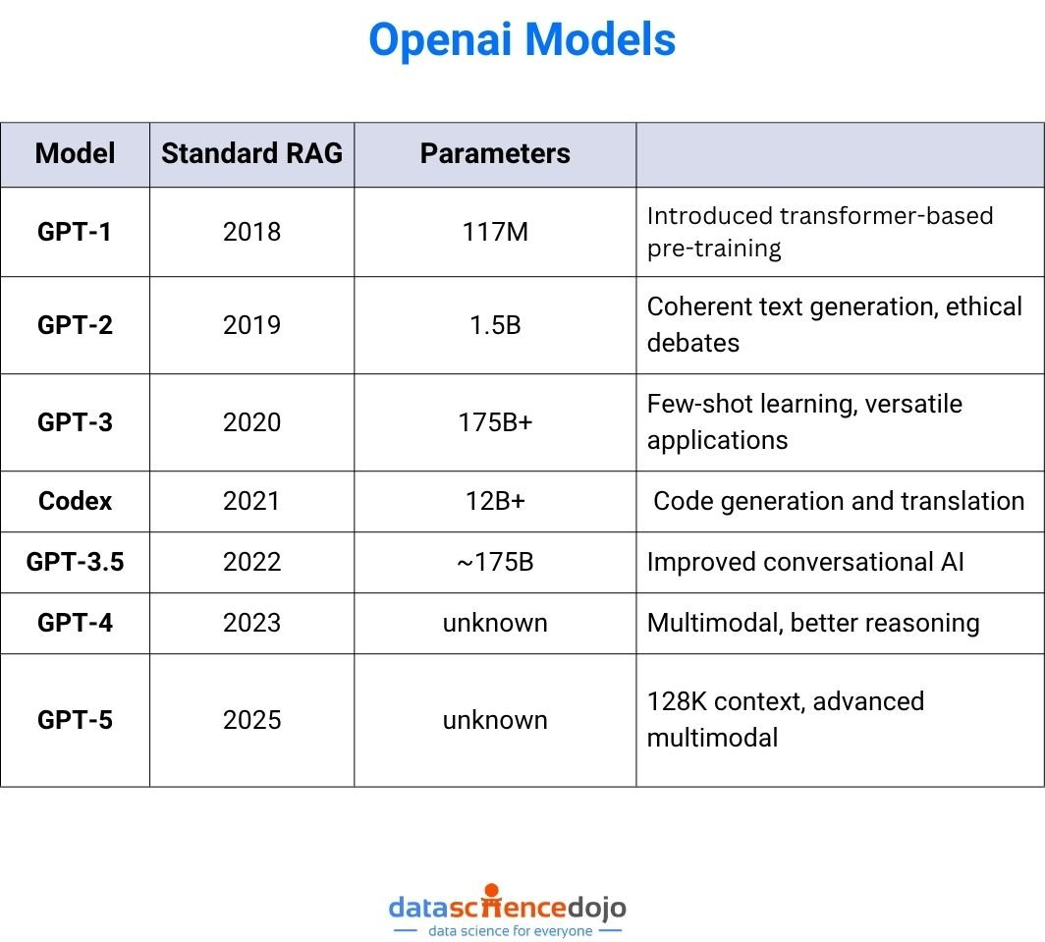

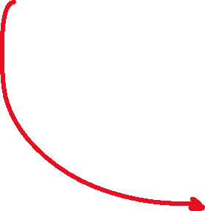

What is a Large Language Model ?
Neural network designed to understand , generate and respond to human like text
Deep Neural Network rained on massive amount of data
Large Language Model
massive amounts of text with billions of parameters
A language model is an AI system that predicts the next word in a sentence based on the words that came before it.
Task : QnA, translation, sentiment analysis

Slide 3
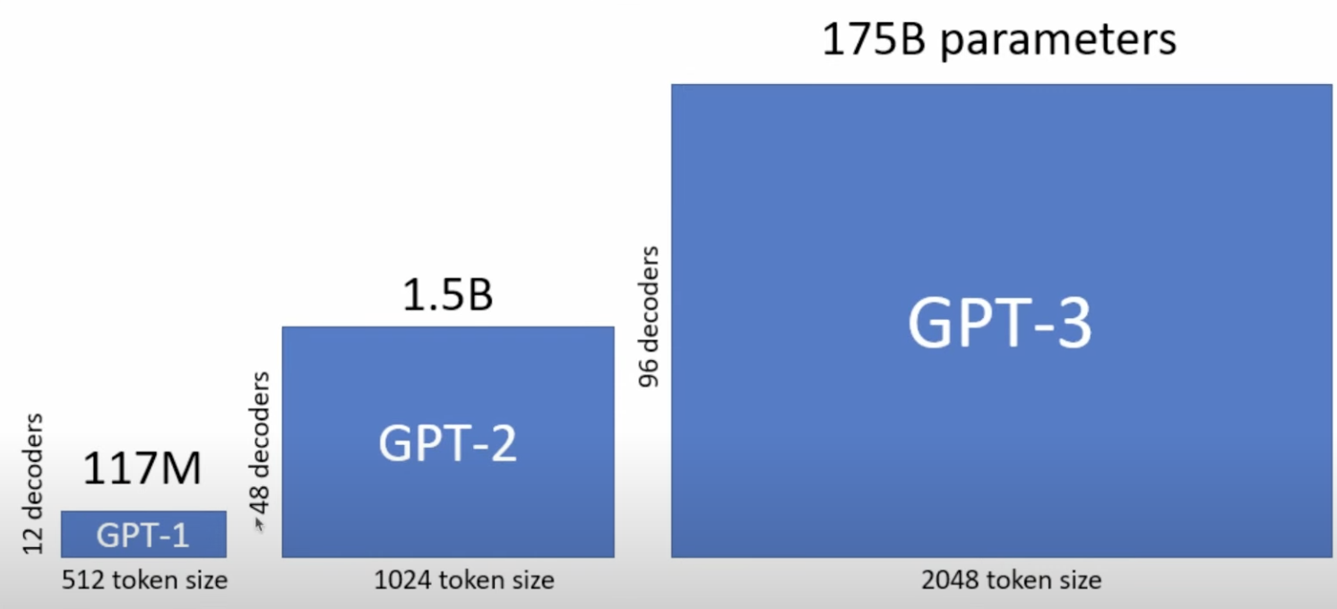

Slide 4
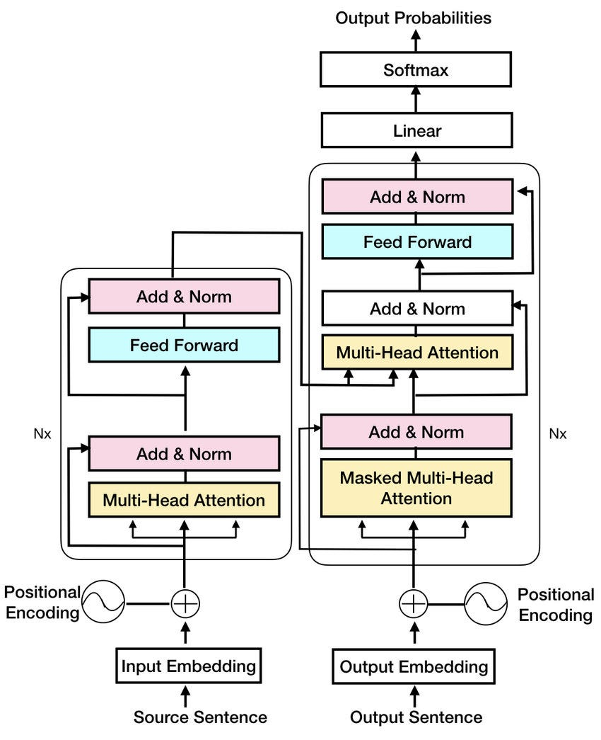
What makes LLMs so Good !! Transformer Architecture
Attnetion is all you need
Link to Paper
Deep neural network architecture

Slide 5
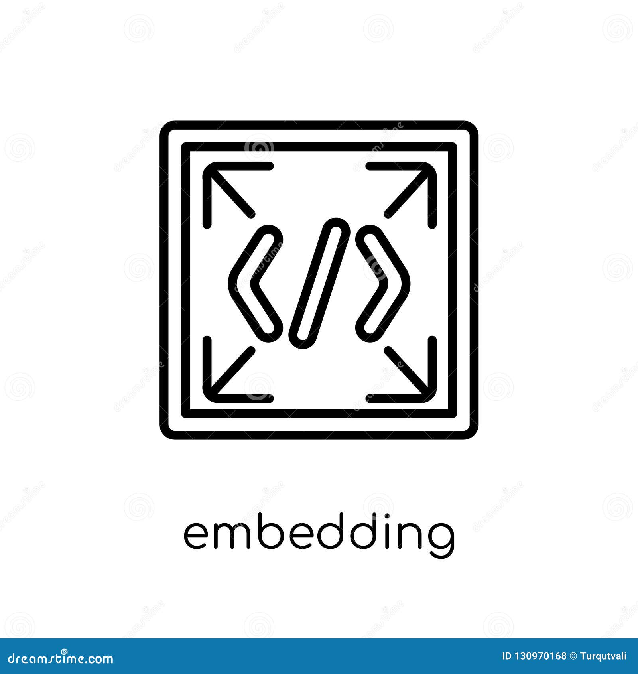

















Simplified Architecture
Complete output (translation)
Morgan Stanley es una firma increíble.
Encoder returns vector embeddings as input to decoder
Embeddings
Output Layer
Produces text encodings used by decoder
Generates translated one word at a time
Encoder
Decoder
Processing Step
Input text is prepared for decoder
Processing Step
Input text prepared for encoder.
Tokenisation
Input Text
Input Text
" Morgan Stanley is an amazing firm"
"Morgan Stanley es "
Input the text to be translated
Partial translation output text
Model completes one word at a time
Case of simple translation from English to Spanish

Slide 6
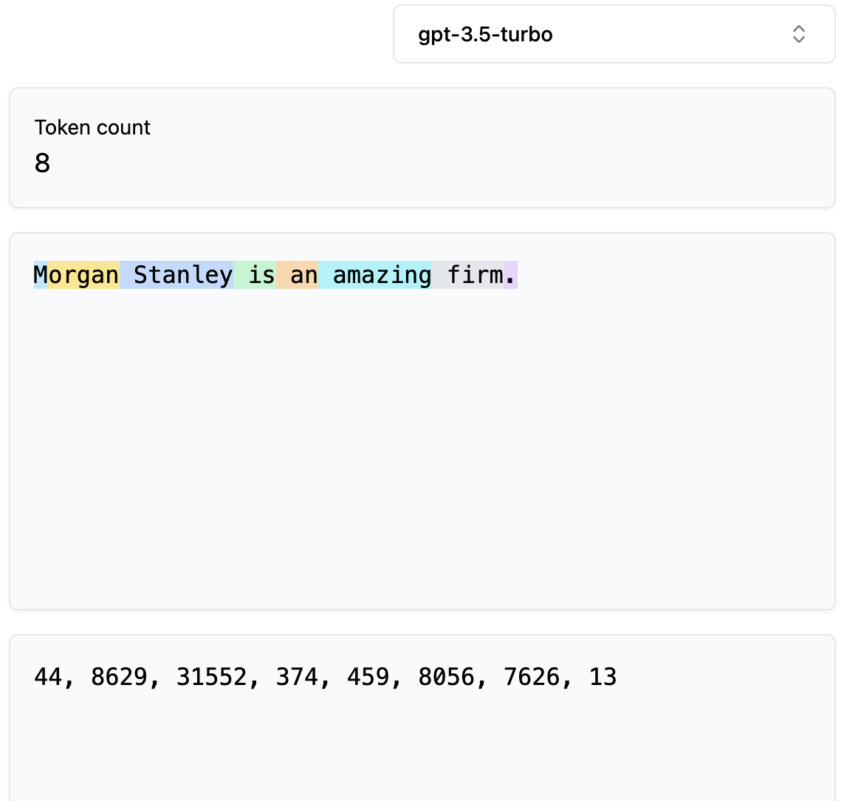
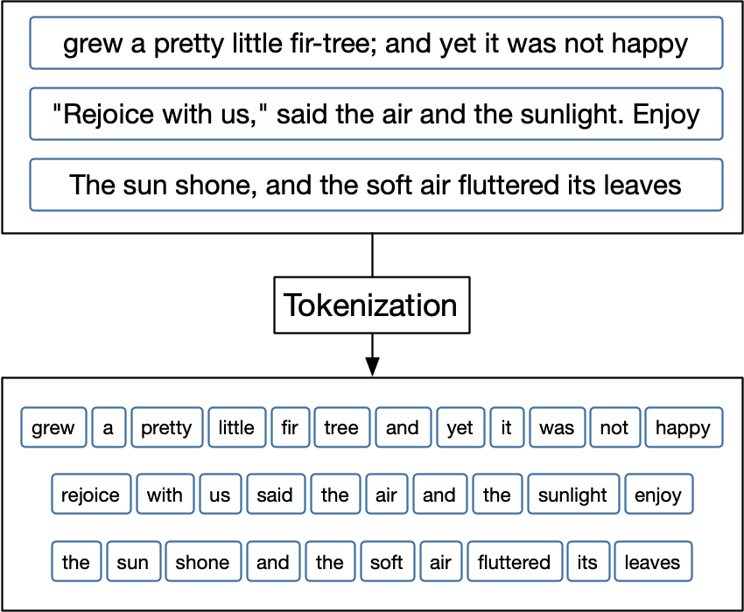

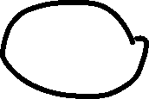




Intuition of tokenization
Assign a unique number to the each word

Slide 7
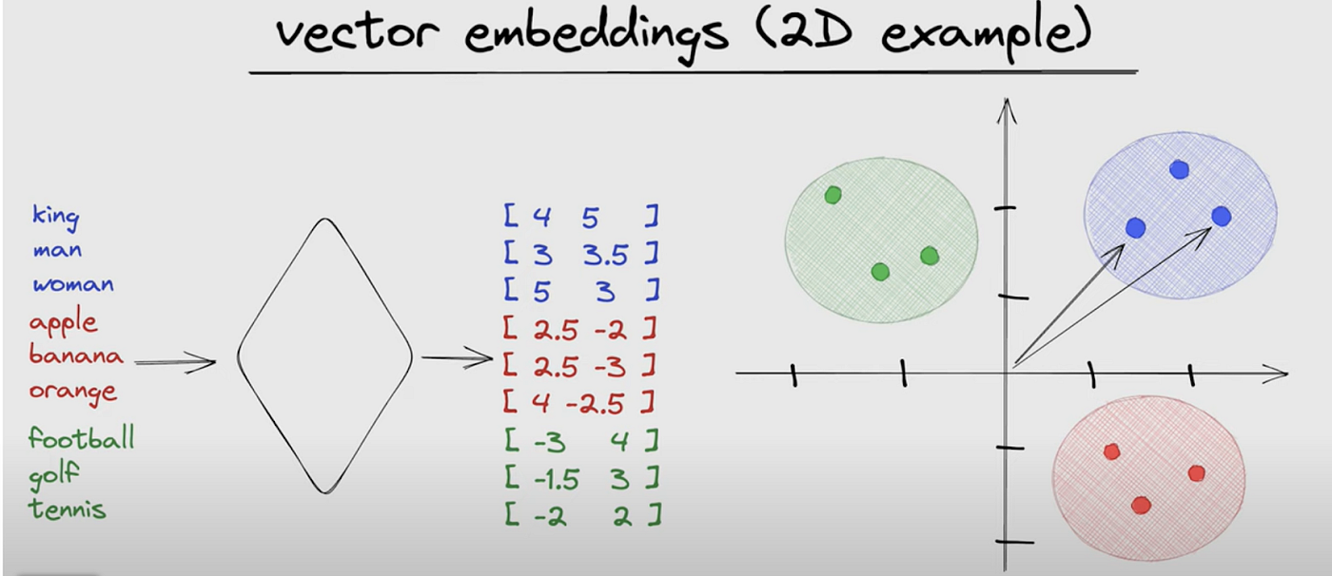
Intuition of encoding – vector embeddings

Slide 8
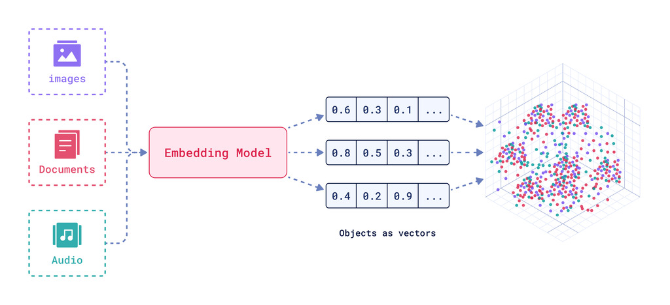

Slide 9
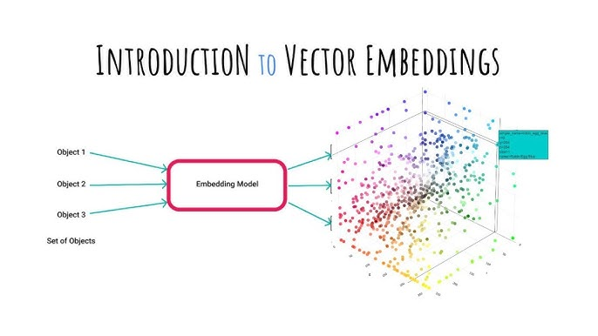

Slide 10

Encoder
Decoder
Encodes text into vector
Generates output text from encoded vectors
Attention
Key part of transformer architecture : Self – attention mechanism
Allows model to weigh importance of different words/ tokens relative to each other.
Enables model to compute long range dependencies.

Slide 11
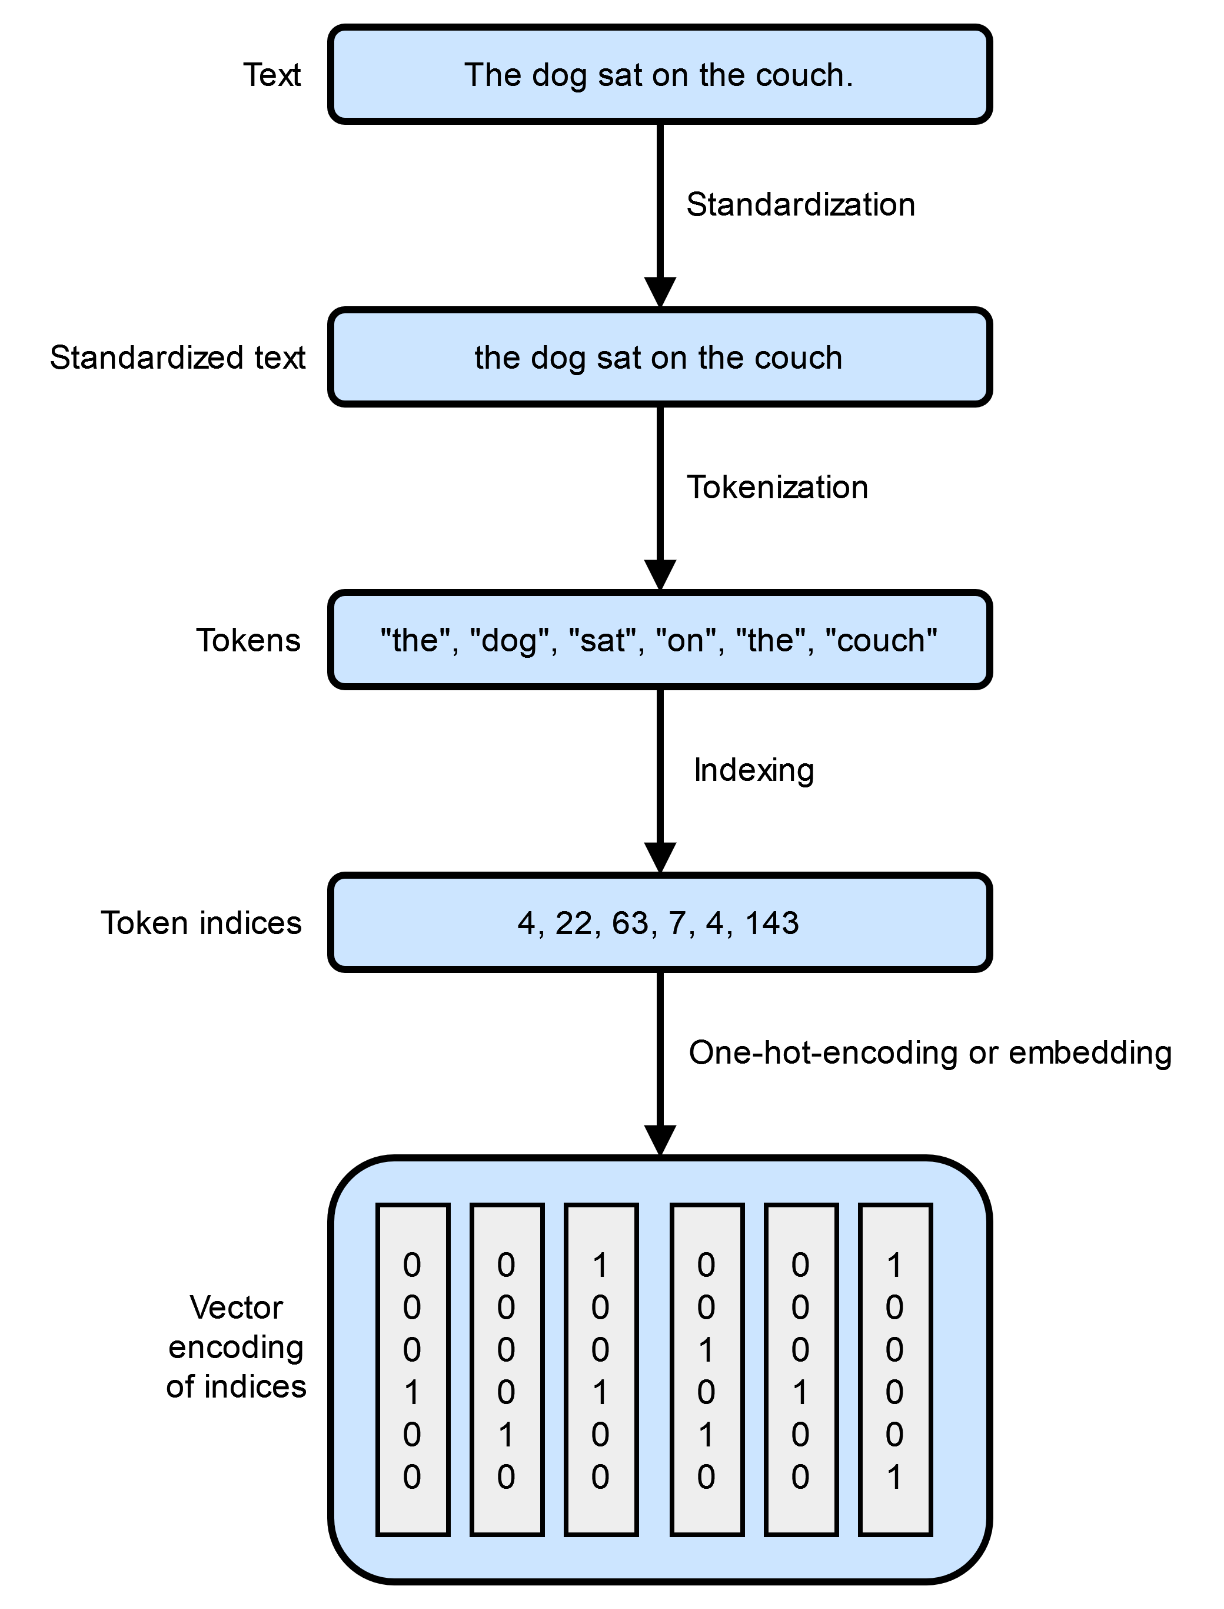




Data Preparation and Sampling
Step 1 : Splitting text into individual words and Sub-word
Step 2 : Convert Tokens into Token IDs
Step 3 : Encode these Token IDs into vector Embeddings

Slide 12









Tokenization – Deep Dive.
Complete Training Dataset
Tokenised
Text
Vocabulary
Brown
Dog
Fox
Jumps
The quick brown fox jumps over a lazy dog.
The quick brown fox
jumps over a lazy
dog
Each unique token is mapped to an integer
Do you see the problem here ….. ??

Slide 13











Tokenization Algorithm
Word Based
Sub-word Based
Character Based
The quick brown fox jumps over a lazy dog.
Earth revolves around the Sun
The quick brown fox
jumps over a lazy
dog
[ 'E', 'a', 'r', 't', 'h', 'v', ---------]
Very small vocabulary
Every language has fixed number of characters [26 alphabets] .. total [~256]
Problem :
meaning associate with word is completely lost
Tokenised sequence is far bigger than original
Problem : out of vocabulary words (OOV)
Words with similar meanings are characterized different

Slide 14
Sub-word based tokenization
Rule 1 : Split the rare words into smaller meaningful sub-words
Rule 2 : Do not split frequently used words into smaller sub-words
Notes
(a) The subword splitting helps the model learn that different words with same root word as
"token", "tokenizer", "tokenisation"
are similar in meaning
(b) It also helps model learn that "tokenisation" and " modernisation" are made of different root word but have the same suffix and are used in same syntatic situation
Byte Pair Encoding (BPE) is a method that keeps merging the most common pairs of letters or symbols into new ones to represent text more efficiently.

Slide 15
Token embeddings
Computers need numerical representation of words
How can we represent words in numbers ?
Can we assign random numbers to each word ?
The Problem with using Random numbers
Cat -----> 34
Book -----> 2.9
Tablet -----> -20
Kitten -----> -13
"Cat" and "Kitten" are semantically related. However the numerical representation above 34 and –13 cannot capture that relationship.

Slide 16
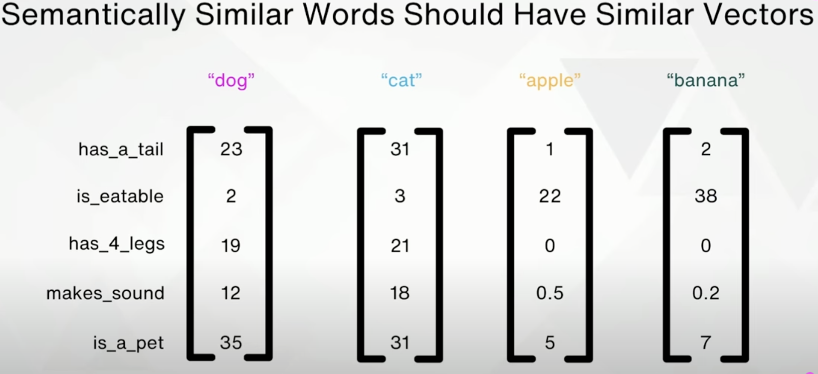
Why don’t we represent each word (token) as a vector?
----->
----->

Slide 17
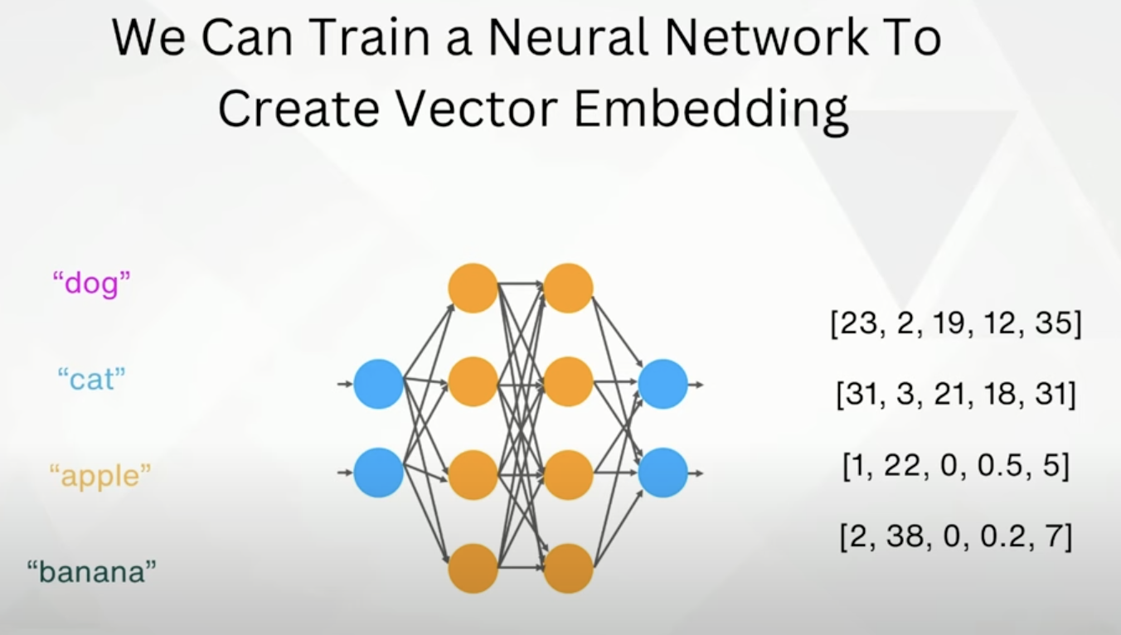
Lets look at an example – real world

Slide 18
How are token embeddings created for LLMs?
(a) Initialise embedding weights with random values
(b) This intialisation serves as the starting point for LLM learning process
(c) The embedding weights are optimised as part of the LLM training process.
(d) The embedding layer is a lookup operation that retrives rows from the embedding layer weight matric using a token ID

Slide 19






The quick brown fox
jumps over a lazy
dog
Vector Dimension
Token IDs
Brown
Dog
Fox
Jumps
lazy
Over
Quick
the
Token IDs are converted into embedding vectors
Vocabulary Size
Embedding layer weight matrix
Traiing data has information embeeded in it . We know which word is closer and which are not. Training data is used as underlying info to optimize the parameters.

